Slide 1
INTRO to DATA SCIENCE map-reduce

Slide 2
I. big data ii. programming model iii. Implementation details iv. Word count example exercise: v. Map-reduce using python
agenda

Slide 3
I. big data
INTRO TO DATA SCIENCE

Slide 4
Big data
As you have probably heard, big data is a hot topic these days.

Slide 5
Big data
As you have probably heard, big data is a hot topic these days.
Q: What does “big data” actually refer to?

Slide 6
Big data
As you have probably heard, big data is a hot topic these days.
Q: What does “big data” actually refer to?
A: Scalability; in particular, storing & processing web-scale (multi-
terabyte) datasets…

Slide 7
Big data
As you have probably heard, big data is a hot topic these days.
Q: What does “big data” actually refer to?
A: Scalability; in particular, storing & processing web-scale (multi-
terabyte) datasets…
But this is only half of the story…how would you do this?

Slide 8
Big data
One approach would be to get a huge supercomputer.

Slide 9
Big data
One approach would be to get a huge supercomputer.
But this has some obvious drawbacks:
- expensive
- difficult to maintain
- scalability is bounded

Slide 10
Big data
Instead of one huge machine, what if we got a bunch of regular (commodity) machines?

Slide 11
Big data
Instead of one huge machine, what if we got a bunch of regular (commodity) machines?
This has obvious benefits!
- cheaper
- easier to maintain
- scalability is unbounded (just add more nodes to the cluster)

Slide 12
Big data
Now we can give a complete answer to our earlier question.
Q: What does “big data” actually refer to?

Slide 13
Big data
Now we can give a complete answer to our earlier question.
Q: What does “big data” actually refer to?
A: Scalability; in particular, storing & processing web-scale (multi-
terabyte) datasets using clusters of multiple computing nodes.

Slide 14
Big data
Now we can give a complete answer to our earlier question.
Q: What does “big data” actually refer to?
A: Scalability; in particular, storing & processing web-scale (multi-
terabyte) datasets using clusters of multiple computing nodes.
“Scale out vs scale up!”

Slide 15
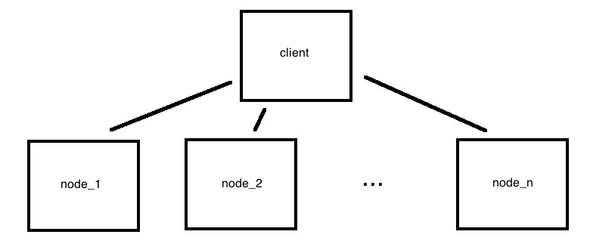
Big data
We can visualize this horizontal cluster architecture as a single client-multiple server relationship

Slide 16

Big data
We can visualize this horizontal cluster architecture as a single client-multiple server relationship
NOTE
A horizontally distributed system also has better fault tolerance than a single machine.
Notes:
replication, re-execution

Slide 17
Big data
There are two ways to process data in a distributed architecture:
1) move data to cores (& code)
2) move code to data (& cores)

Slide 18
Big data
There are two ways to process data in a distributed architecture:
1) move data to cores (& code)
- SETI@home
2) move code to data (& cores)
- map-reduce → less overhead (network traffic, disk I/O)
“Computing nodes are the same as storage nodes.”

Slide 19
Aside: divide and conquer algorithms
Divide and conquer is a fundamental algorithmic technique for solving a given task, whose steps include:

Slide 20
Aside: divide and conquer algorithms
Divide and conquer is a fundamental algorithmic technique for solving a given task, whose steps include:
1) split task into subtasks
2) solve these subtasks independently
3) recombine the subtask results into a final result

Slide 21
Aside: divide and conquer algorithms
Divide and conquer is a fundamental algorithmic technique for solving a given task, whose steps include:
1) split task into subtasks
2) solve these subtasks independently
3) recombine the subtask results into a final result
This is how recursive algorithms work, for example.
Notes:
Not necessarily a perfect comparison to recursive algorithms, but it’ll do.

Slide 22

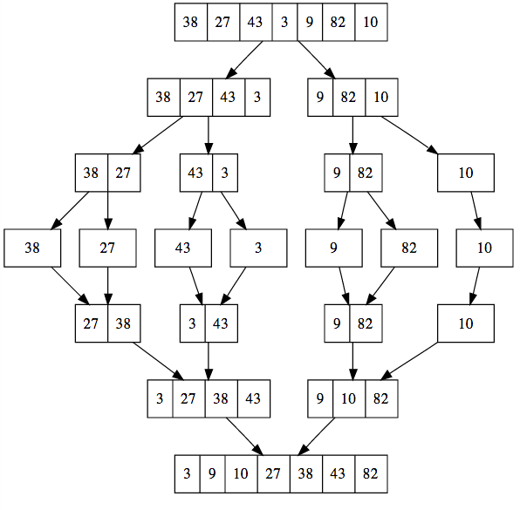
Aside: divide and conquer algorithms
One famous example of divide and conquer is merge sort.
Notes:
(It’s Von Neumann, inventer of merge sort (among other things).)

Slide 23
Aside: divide and conquer algorithms
Map-reduce leverages the divide and conquer approach by splitting a large dataset into several smaller datasets and performing a computation on each of these in parallel.

Slide 24
Aside: divide and conquer algorithms
Map-reduce leverages the divide and conquer approach by splitting a large dataset into several smaller datasets and performing a computation on each of these in parallel.
In fact, running a map-reduce job with identity (eg, do-nothing) mappers and reducers is similar to merge sort!

Slide 25
Aside: divide and conquer algorithms
Map-reduce leverages the divide and conquer approach by splitting a large dataset into several smaller datasets and performing a computation on each of these in parallel.
In fact, running a map-reduce job with identity (eg, do-nothing) mappers and reducers is similar to merge sort!
(The similarity is approximate, because results are output in multiple sets, and data is not broken down to single-element subsets.)
Notes:
Also: similarity is conceptual…Implementation is different. (And this is referring to the oft-neglected shuffle step.)

Slide 26
Aside: divide and conquer algorithms
The defining characteristic of a problem that is suitable for the divide and conquer approach is that it can be broken down into independent subtasks.

Slide 27
Aside: divide and conquer algorithms
The defining characteristic of a problem that is suitable for the divide and conquer approach is that it can be broken down into independent subtasks.
Tasks that can be parallelized in this way include:
- count, sum, average
- grep, sort, inverted index
- graph traversals, some ML algorithms

Slide 28
Aside: divide and conquer algorithms
The defining characteristic of a problem that is suitable for the divide and conquer approach is that it can be broken down into independent subtasks.
Tasks that can be parallelized in this way include:
- count, sum, average
- grep, sort, inverted index
- graph traversals, some ML algorithms
NOTE
Parallelizing an ML algorithm can be a non-trivial exercise!

Slide 29
II. programming model
INTRO TO DATA SCIENCE

Slide 30
Map-reduce
As we’ve discussed, the map-reduce approach involves splitting a problem into subtasks and processing these subtasks in parallel.

Slide 31
Map-reduce
As we’ve discussed, the map-reduce approach involves splitting a problem into subtasks and processing these subtasks in parallel.
This takes place in two phases:

Slide 32
Map-reduce
As we’ve discussed, the map-reduce approach involves splitting a problem into subtasks and processing these subtasks in parallel.
This takes place in two phases:
1) the mapper phase
2) the reducer phase

Slide 33
Map-reduce
As we’ve discussed, the map-reduce approach involves splitting a problem into subtasks and processing these subtasks in parallel.
This takes place in (approximately) two phases:
1) the mapper phase
1.5) shuffle/sort
2) the reducer phase

Slide 34
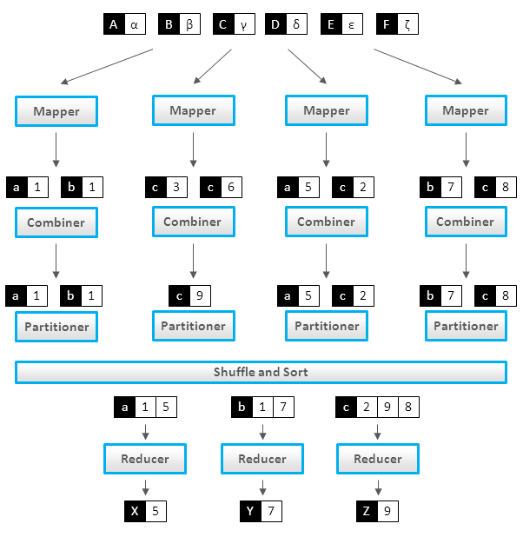
Map-reduce

Slide 35
Map-reduce
Map-reduce uses a functional programming paradigm. The data processing primitives are mappers and reducers, as we’ve seen.

Slide 36
Map-reduce
Map-reduce uses a functional programming paradigm. The data processing primitives are mappers and reducers, as we’ve seen.
mappers – filter & transform data
reducers – aggregate results

Slide 37
Map-reduce
Map-reduce uses a functional programming paradigm. The data processing primitives are mappers and reducers, as we’ve seen.
mappers – filter & transform data
reducers – aggregate results
The functional paradigm is good at describing how to solve a problem, but not very good at describing data manipulations (eg, relational joins).

Slide 38
Map-reduce
As our earlier diagram suggests, there are additional intermediate steps in a map-reduce workflow.
mappers – filter & transform data
reducers – aggregate results

Slide 39
Map-reduce
As our earlier diagram suggests, there are additional intermediate steps in a map-reduce workflow.
mappers – filter & transform data
combiners – perform reducer operations on the mapper node (optional
step, to reduce network traffic and disk I/O).
partitioners – shuffle/sort/redirect mapper output
reducers – aggregate results
Notes:
note: combiners are useful if mappers emit multiple values per key

Slide 40
Map-reduce

Slide 41
Map-reduce
It’s possible to overlay the map-reduce framework with an additional declarative syntax.
This makes operations like select & join easier to implement and less error prone.
Popular examples include Pig and Hive.

Slide 42

Map-reduce
source: http://www.slideshare.net/kevinweil/hadoop-pig-and-twitter-nosql-east-2009

Slide 43
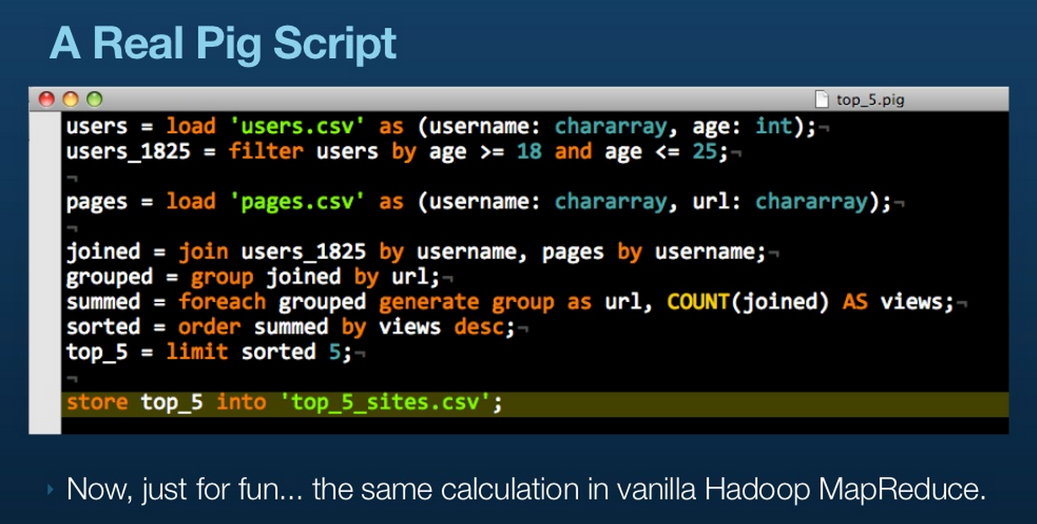
Map-reduce

Slide 44
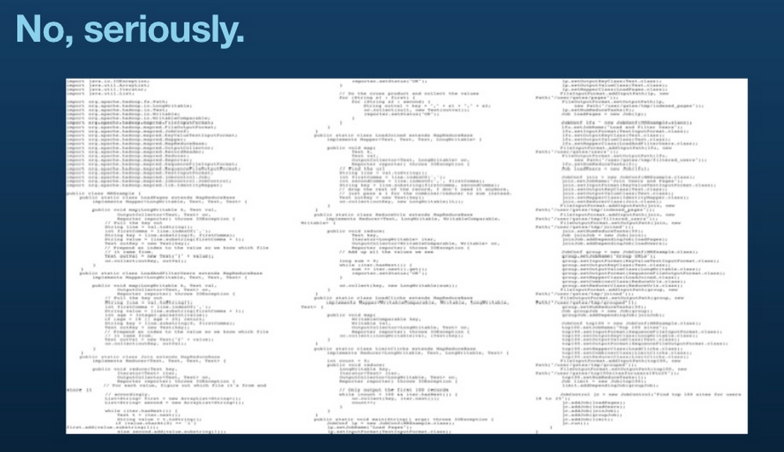
Map-reduce

Slide 45
III. implementation details
INTRO TO DATA SCIENCE

Slide 46
Implementation details
The map-reduce framework handles a lot of messy details for you:

Slide 47
Implementation details
The map-reduce framework handles a lot of messy details for you:
- parallelization & distribution (eg, input splitting)
- partitioning (shuffle/sort/redirect)
- fault-tolerance (fact: tasks/nodes will fail!)
- I/O scheduling
- status and monitoring

Slide 48
Implementation details
The map-reduce framework handles a lot of messy details for you:
- parallelization & distribution (eg, input splitting)
- partitioning (shuffle/sort/redirect)
- fault-tolerance (fact: tasks/nodes will fail!)
- I/O scheduling
- status and monitoring
This (along with the functional semantics) allows you to focus on solving the problem instead of accounting & housekeeping details.

Slide 49
hadoop
Hadoop is a popular open-source Java-based implementation of the map-reduce framework (including file storage for input/output).

Slide 50
hadoop
Hadoop is a popular open-source Java-based implementation of the map-reduce framework (including file storage for input/output).
You can download Hadoop and configure a set of machines to operate as a map-reduce cluster, or you can run it as a service via Amazon’s Elastic Map-Reduce.

Slide 51
hadoop
Hadoop is a popular open-source Java-based implementation of the map-reduce framework (including file storage for input/output).
You can download Hadoop and configure a set of machines to operate as a map-reduce cluster, or you can run it as a service via Amazon’s Elastic Map-Reduce.
Hadoop is written in Java, but the Hadoop Streaming utility allows client code to be supplied as executables (eg, written in any language).

Slide 52
hadoop
Frequently when people say “map-reduce” they’re referring to Hadoop, but there are some exceptions:

Slide 53
hadoop
Frequently when people say “map-reduce” they’re referring to Hadoop, but there are some exceptions:
- many NoSQL databases support native map-reduce queries
- commercial distributions (Cloudera, MapR, etc)
- Google’s internal implementation

Slide 54
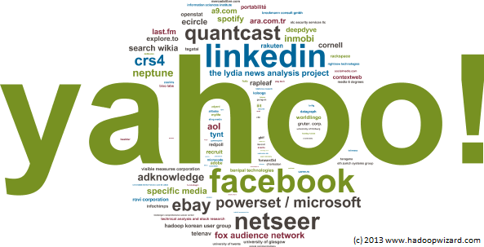
hadoop
That said, Hadoop has a large user base.
source: http://www.hadoopwizard.com/which-big-data-company-has-the-worlds-biggest-hadoop-cluster/
Notes:
name size ~ cluster size

Slide 55
Under the hood
Data is replicated in the (distributed) file system across several nodes.

Slide 56
Under the hood
Data is replicated in the (distributed) file system across several nodes.
This permits locality optimization (and fault tolerance) by allowing the mapper tasks to run on the same nodes where the data resides.

Slide 57
Under the hood
Data is replicated in the (distributed) file system across several nodes.
This permits locality optimization (and fault tolerance) by allowing the mapper tasks to run on the same nodes where the data resides.
So we move code to data (instead of data to code), thus avoiding a lot of network traffic and disk I/O.

Slide 58
Under the hood
Data is replicated in the (distributed) file system across several nodes.
This permits locality optimization (and fault tolerance) by allowing the mapper tasks to run on the same nodes where the data resides.
So we move code to data (instead of data to code), thus avoiding a lot of network traffic and disk I/O.
NOTE
“Compute nodes are the same as storage nodes.”

Slide 59
Under the hood
The Google File System (GFS) was developed alongside map-reduce to serve as the native file system for this type of processing.

Slide 60
Under the hood
The Google File System (GFS) was developed alongside map-reduce to serve as the native file system for this type of processing.
The Hadoop platform is bundled with an open-source implementation of this file system called HDFS.

Slide 61
Under the hood
The Google File System (GFS) was developed alongside map-reduce to serve as the native file system for this type of processing.
The Hadoop platform is bundled with an open-source implementation of this file system called HDFS.
If you use Amazon EMR, you can use Amazon S3.

Slide 62
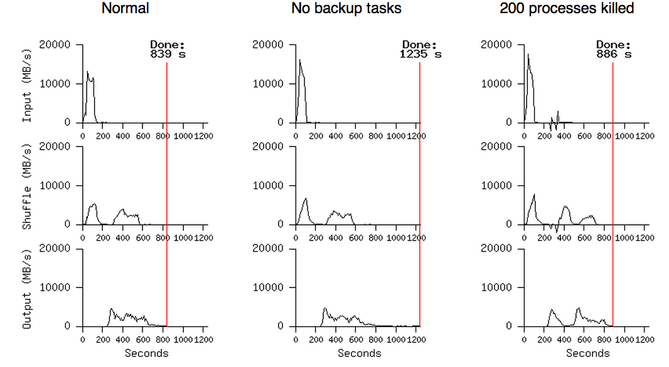
Under the hood
Notes:
Native monitoring, backup scheduling, fault tolerance

Slide 63
iV. Word count example
INTRO TO DATA SCIENCE

Slide 64
example
Map-reduce processes data in terms of key-value pairs:
input <k1, v1>
mapper <k1, v1> → <k2, v2>
(partitioner) <k2, v2> → <k2, [all k2 values]>
reducer <k2, [all k2 values]> → <k3, v3>

Slide 65
Map-reduce example
Using the following input, we can implement the “Hello World” of map-reduce: a word count.

Slide 66
Map-reduce example: mapper input
Using the following input, we can implement the “Hello World” of map-reduce: a word count.
where
where in
where in the
where in the world
where in the world is
where in the world is carmen
where in the world is carmen sandiego

Slide 67
Map-reduce example: mapper
The first processing primitive is the mapper, which filters & transforms the input data, and emits transformed key-value pairs.

Slide 68
Map-reduce example: mapper
The first processing primitive is the mapper, which filters & transforms the input data, and emits transformed key-value pairs.
mapper(k1, v1):
// k1 = line number
// v1 = line contents (eg, space-delimited string)
words = tokenize(v1) // split string into words
for word in words:
emit (word, 1)

Slide 69
Map-reduce example: mapper output
The mapper emits key-value pairs for each word encountered in the input data.

Slide 70
Map-reduce example: mapper output
The mapper emits key-value pairs for each word encountered in the input data.
where 1
where 1
in 1
where 1
in 1
the 1
...

Slide 71
Map-reduce example: partitioner
The partitioner is internal to the map-reduce framework, so we don’t have to write this ourselves. It shuffles & sorts the mapper output, and redirects all intermediate results for a given key to a single reducer.

Slide 72
Map-reduce example: partitioner output
The partitioner is internal to the map-reduce framework, so we don’t have to write this ourselves. It shuffles & sorts the mapper output, and redirects all intermediate results for a given key to a single reducer.
where [1, 1, 1, 1, 1, 1, 1]
in [1, 1, 1, 1, 1, 1]
the [1, 1, 1, 1, 1]
world [1, 1, 1, 1]
is [1, 1 ,1]
carmen [1, 1]
sandiego [1]

Slide 73
Map-reduce example: reducer
Finally, the reducer receives all values for a given key and aggregates (in this case, sums) the results.

Slide 74
Map-reduce example: reducer
Finally, the reducer receives all values for a given key and aggregates (in this case, sums) the results.
reducer(k2, k2_vals):
// k2 = word
// k2_vals = word counts
emit k2, sum(k2_vals)

Slide 75
Map-reduce example: reducer output
Reducer output is aggregated…
where 7
in 6
the 5
world 4
is 3
carmen 2
sandiego 1

Slide 76
Map-reduce example: reducer output
Reducer output is aggregated & sorted by key.
carmen 2
is 3
in 6
the 5
sandiego 1
where 7
world 4

Slide 77
V. Exercise
INTRO TO DATA SCIENCE

